Slide 1
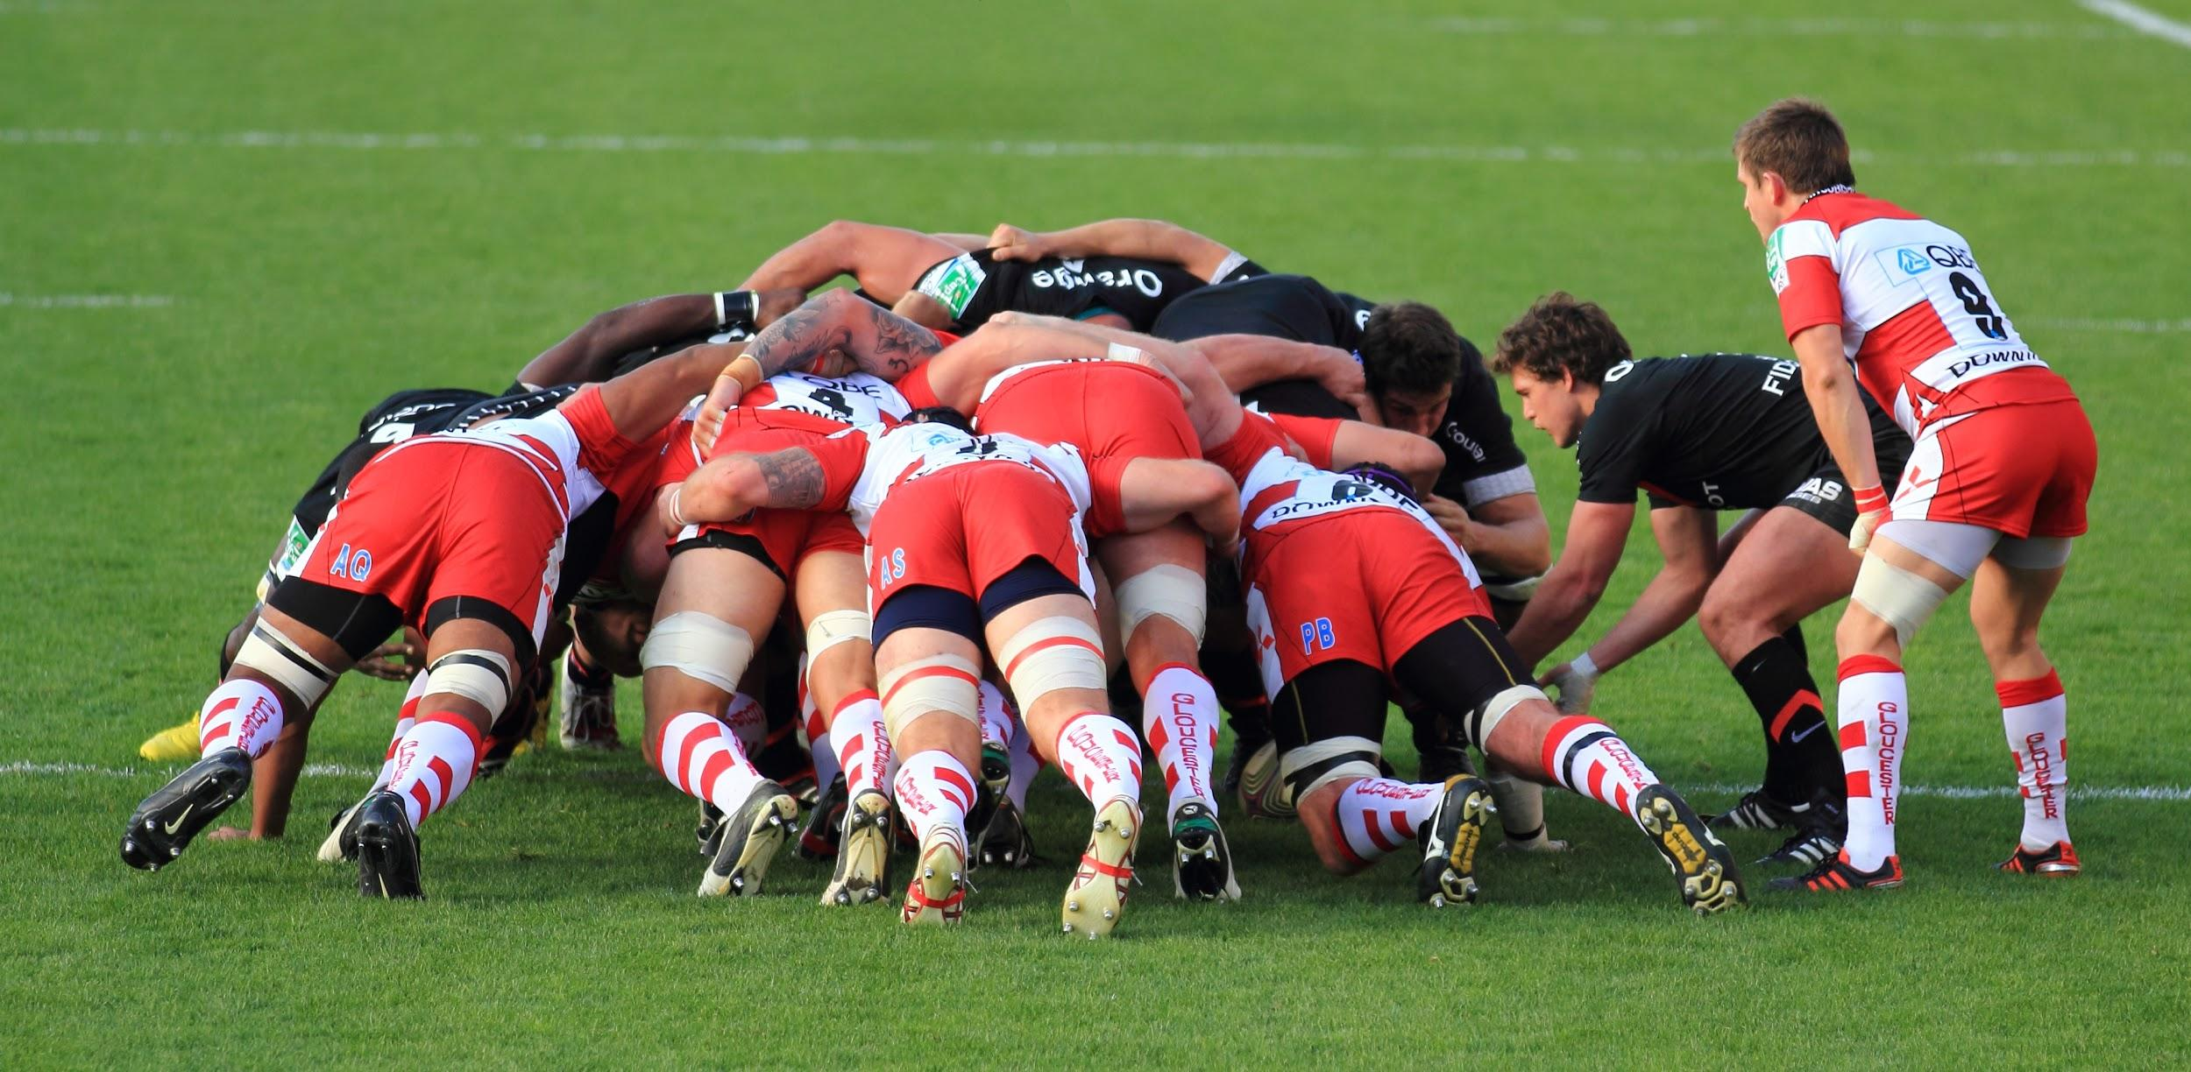
Agile in the core

Slide 2

Agile - Introduction
Why many projects are perceived as not successful?
• The solution does not deliver what the business needs
• The solution has a lot of hindering errors
• The solution has overall poor performance
• The solution is not accepted by the end user population
• The solution is very difficult to maintain
• The project runs over time and over budget

Slide 3

Agile Manifesto
Individuals and interactions over processes and tools
Working software over comprehensive documentation
Customer collaboration over contract negotiation
Responding to change over following a plan
That is, while there is value in the items on the right, we value the items on the left more.

Slide 4
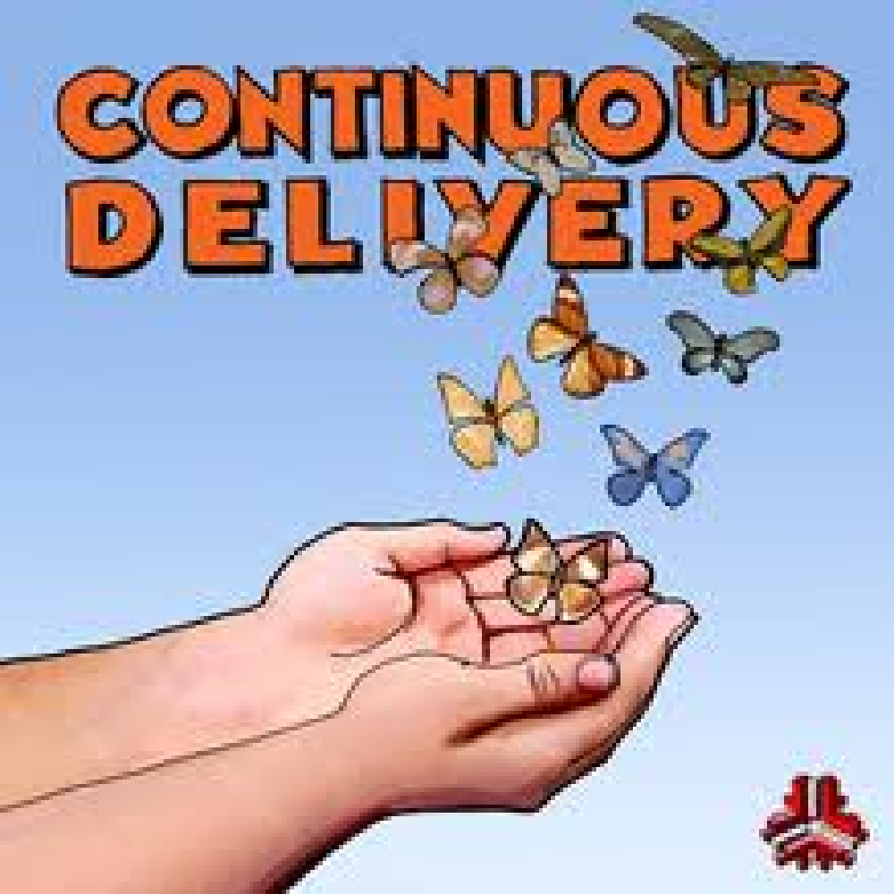
Principles behind the Agile manifesto
1. Our highest priority is to satisfy the customer through early and continuous delivery of valuable software.
2. Welcome changing requirements, even late in development. Agile processes harness change for the customer's competitive advantage.
3. Deliver working software frequently, from a couple of weeks to a couple of months, with a preference to the shorter timescale.

Slide 5
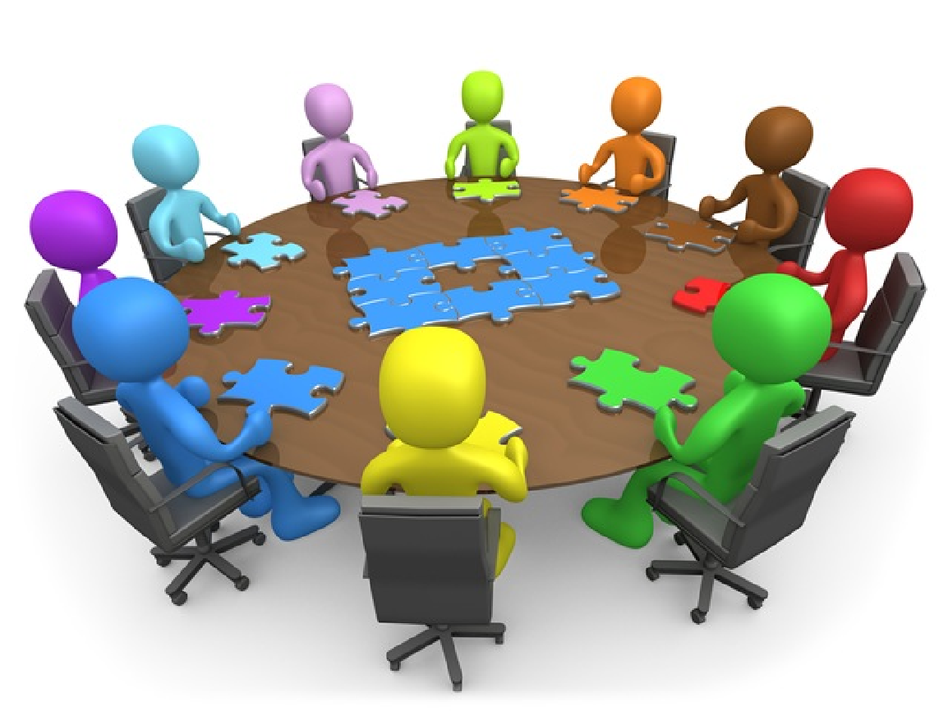
Principles behind the Agile manifesto
4. Business people and developers must work together daily throughout the project.
5. Build projects around motivated individuals. Give them the environment and support they need, and trust them to get the job done.
6. The most efficient and effective method of conveying information to and within a development team is face-to-face conversation.

Slide 6

Principles behind the Agile manifesto
7. Working software is the primary measure of progress.
Agile processes promote sustainable development.
8. The sponsors, developers, and users should be able to maintain a constant pace indefinitely.
9. Continuous attention to technical excellence and good design enhances agility.

Slide 7
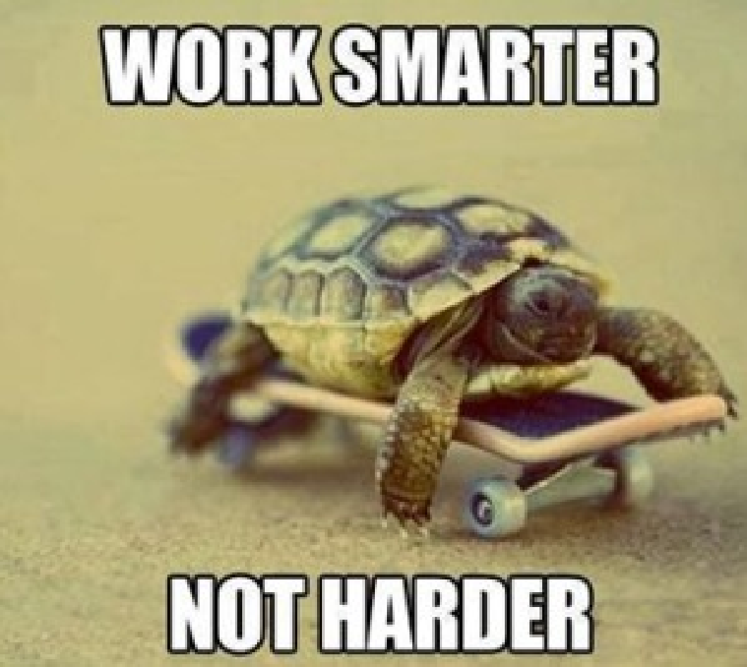
Principles behind the Agile manifesto
10. Simplicity--the art of maximizing the amount of work not done--is essential.
11. The best architectures, requirements, and designs emerge from self-organizing teams.
12. At regular intervals, the team reflects on how to become more effective, then tunes and adjusts its behavior accordingly.

Slide 8
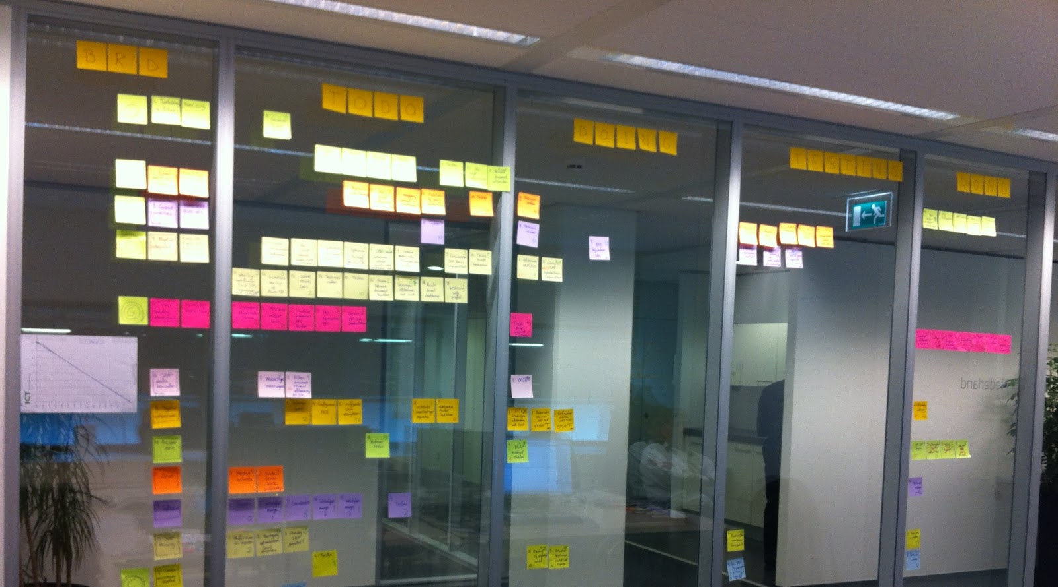
AGILE
Project Management
Let’s SCRUM
Trainer: Daniel Ilinca

Slide 9
SCRUM - roles, artifacts, events
Roles Artifacts Events
Product Owner Product Backlog Sprint
Scrum Master Sprint Backlog Sprint Planning
Development Team User Story Daily Scrum
Definition of Done Sprint Review
Sprint Retrospective

Slide 10
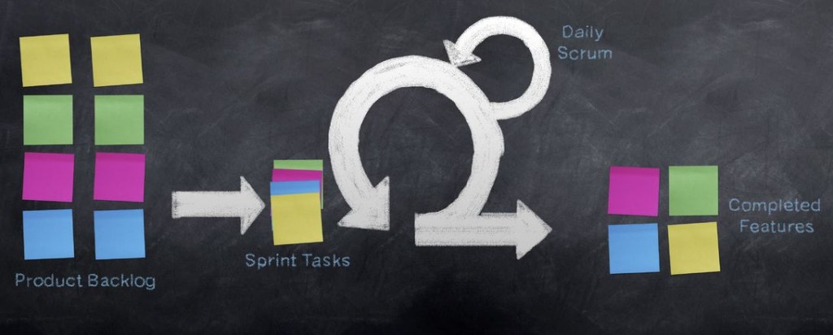
SCRUM - roles, artifacts, events

Slide 11
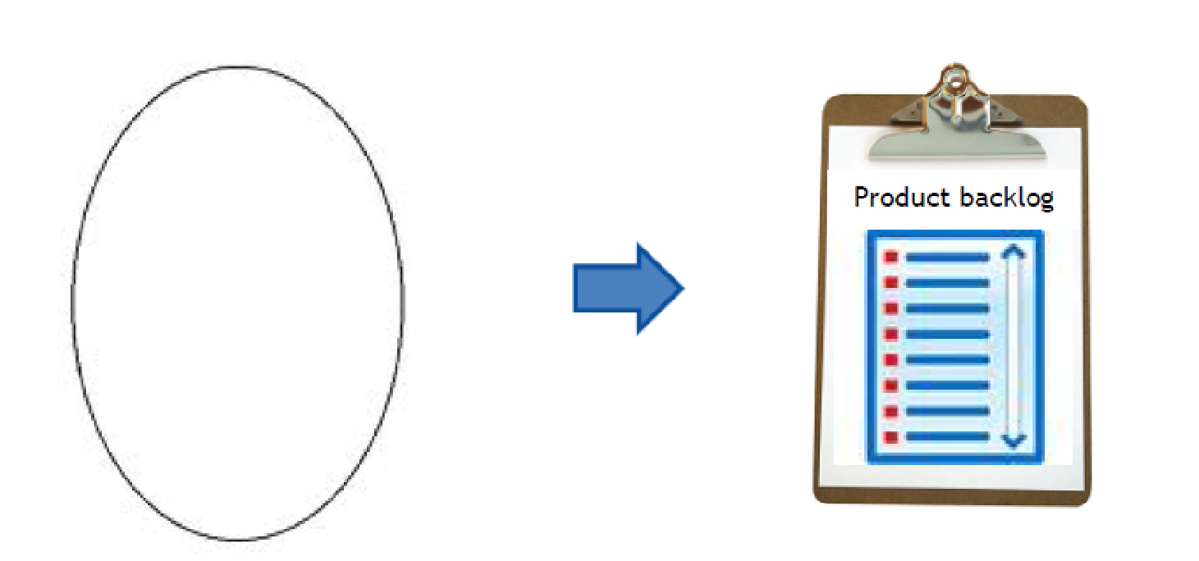
Product backlog
To do-list of things you need to deliver for the project listed in modules, epic stories and user stories

Slide 12
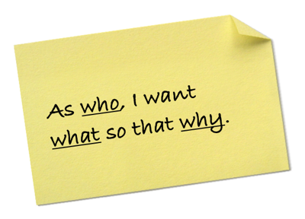
Agile Techniques
User Story
Describes a feature, a small piece of functionality used to incrementally build the application; Formulated in the customer’s terminology.
Represents business value
Independent
Negotiable
Valuable
Estimable
Small
Testable

Slide 13
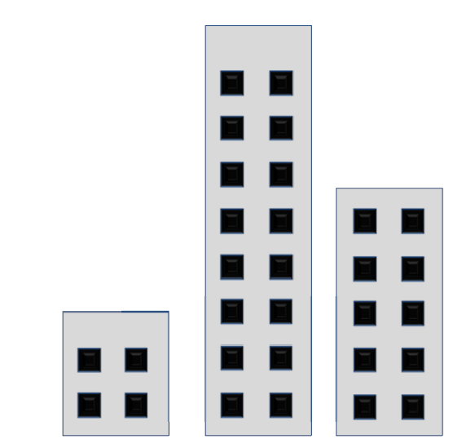
Agile Techniques
Estimation
City landscape
Story points – planning poker

Slide 14
Agile Techniques
Prioritization - MoSCoW
Must have
Without this feature the objectives can not be met
Should Have
Without this feature a workaround has to be created
(which also costs some time)
Could Have
Has a ROI regarding the objectives but can
be missed
Won’t have this time
Does not contribute to the objectives at all

Slide 15
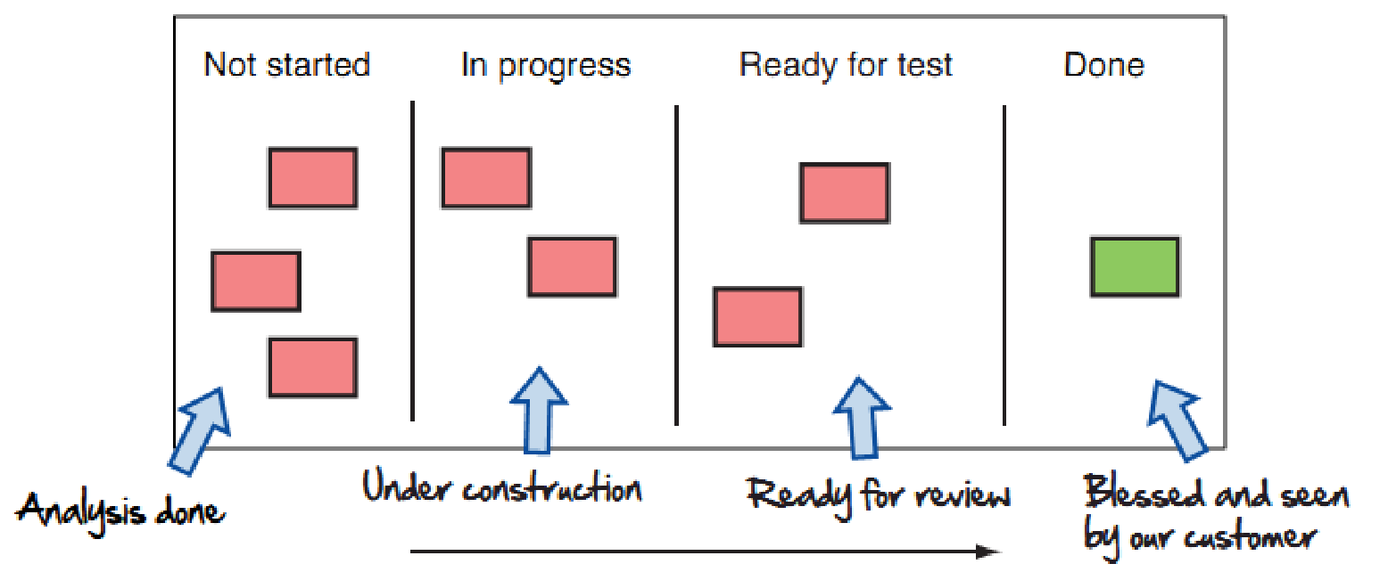
Agile Techniques - Sprint
Daily scrum
When: every day, same time, same place
Max 15 min
Attendees: all team members
Input: individual team member’s state of
workcurrently and completed
Scrum board: makes clear who’s
working on what and visualise sprint
Progress
Agenda:
▪ What did you do yesterday that’s worth mentioning?
▪ What will you do today that helps reaching the spring goal?
▪ What is blocking you?

Slide 16

Agile Techniques - Sprint
Demo/Review/Heartbeat
When: last day of each iteration
Attendees: all team members, stakeholders
Lead: rotation
Input: working and tested software
Agenda:
▪ baseline after iteration
▪ demonstrate new functionalities
▪ generate feedback

Slide 17
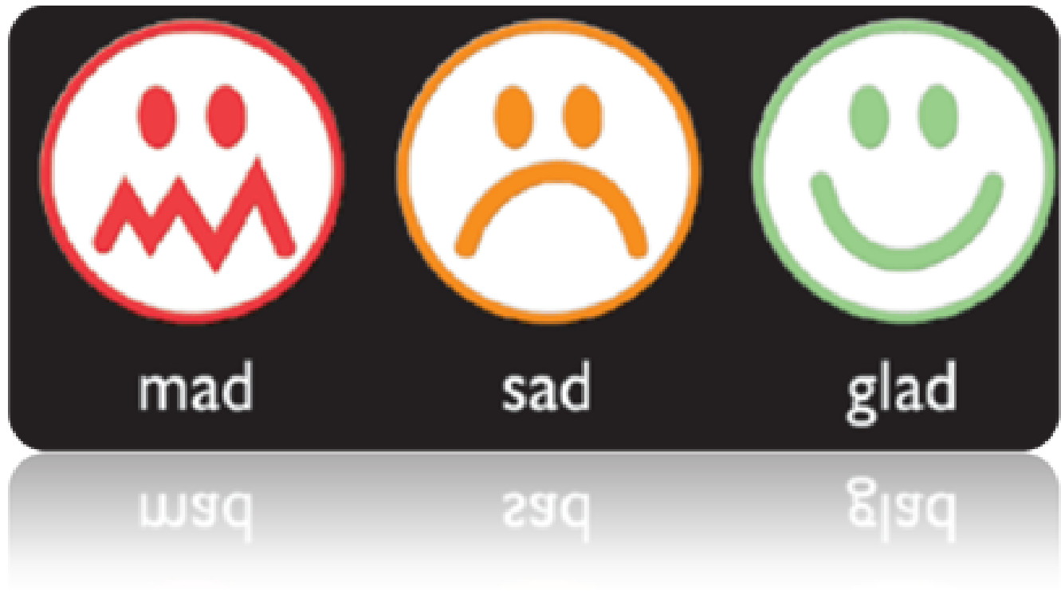
Agile Techniques - Sprint
Retrospectives
When: last day of each iteration
Attendees: all team members and product owner
Lead: rotation
Input: list of good things, not so good things,
Impediments and suggestions/solutions.
Agenda:
▪ discuss actions last retrospective
▪ gather data (what went well? Improved?)
▪ generate insights (why?)
▪ formulate actions

Slide 18
Trello for Scrum #1
Trello - BOARDS
We will have 3 types of trello boards:
1. Product Backlog -this will be only one board for the project. This board will be organized into the following lists of cards:
Ideas - No detail, just a stub for the product owner to develop an idea.
Requirements Gathering - A list of user stories and desired functionality. At this point the card will receive one of these 3 labels - Bug, Enhancement (improve functionality), Feature (create functionality)
Ready for Estimating - at this point user stories are ready for estimation - you should use planning poker and estimate using story points ( Fibonacci numbers) - you need to install this extension - http://scrumfortrello.com/ . The team moves cards from Ready for Estimation to Sprint Candidates during a Sprint Planning meeting. If user stories are not complete, cards get moved back to Requirements Gathering.
Sprint Candidates - For tickets that have been estimated. On this board, the Product Owner is responsible for prioritization of cards within each list using MoSCoW ( Must, Should, Could, Won't ). - http://en.wikipedia.org/wiki/MoSCoW_method - At this point the card will receive one of these 3 labels - Must, Should, Could ( we will not consider the won'ts, these will be deleted or ignored ( no label).

Slide 19
Trello for Scrum #2
2. Sprint Backlog – one board for each Sprint. Cards should only appear on this board if they have been approved for a specific sprint by the Product Owner ( are labeled with Must, Should, Could):
Sprint Backlog - This is ordered based on priority determined by Product Owner.
Blocked - cards not started but blocked by a specific developer.
In progress - cards under development
QA bug reports - This prevents QA testers from moving cards back to the Product Backlog, or straight into “In progress”.
Ready for QA - Cards moved by developers when they are ready for testing
Done - cards tested are ready to be deployed.
You will meet daily, max 15 min to discuss – this is called Daily Meeting/Daily Standup Meeting. Each team member will talk about his/her individual progress.
After each sprint you will do a Demo (Review) and present your magnific progress. ☺ The entire team must join these meetings and sometimes the professor will join as well. :)

Slide 20
Trello for Scrum #3
3.Sprint Retrospective - one board for each Sprint
At the end of each Sprint, the team meets for the Sprint Retrospective. In this meeting the team looks in detail at how things went during the Sprint. They determine and commit to specific action items to make things go better. The team may decide to change something to their process.
You will point out in a separate list for each of these: Successes, Less than successes, What hindered the sprint and Suggestions.
** Each sprint will have 1 week.
** After each sprint we will measure and try to improve the team velocity - number of story points in a sprint.

